Slide 1
Inventory Reconciliation Mini‑App
(Stock In vs Stock Out)

Slide 2
Team Introduction
Areas | Answers
Team Name: | Inventory Reconciliation Team
Batch / Area of Training: | Development
Internship Start Date: | 17th March 2026
Internship Location | Bangalore_SEZ Tower F, 4 Floor
Team Members: | Thutukuri Jagadeesh & Varshith R S

Slide 3
Problem Statement
Questions | Answers
What problem are you trying to solve? | I am solving the issue of frequent mismatches between stock‑in and stock‑out records. Manual checking is slow and error‑prone. The app automates reconciliation to ensure accuracy and speed.
Please define the identified business need and importance to business | Businesses need reliable inventory data to avoid losses and operational delays. Automating reconciliation reduces human errors. It provides faster, more correct visibility of daily stock movement.
Who is affected by this problem? What improvements are assumed to be brought by implementation? | Warehouse teams, inventory managers, and finance teams rely on correct stock data. The solution reduces manual effort and highlights mismatches instantly. It improves operational efficiency and decision‑making.
What made you choose this problem? | Inventory mismatch is a common real‑world challenge across industries. This project provides practical skills in automation, data processing, and dashboards.
Please elaborate any market research conducted help frame the problem. | Many companies still use Excel for daily stock tracking. Research shows manual reconciliation leads to errors and delays. Automation tools are becoming essential for exact inventory management.

Slide 4
Solution Overview/ Idea
Questions | Answers
Please provide short description of the solution | A compact web app that automates stock-in vs. stock-out reconciliation. It processes CSV data, detects mismatches instantly, and presents clear dashboards.
What are the key objectives you are planning to achieve | Automates reconciliation, reduces manual errors, and provides real-time visibility. Enables quick identification of mismatches and generates clean, exportable reports.
How does your solution achieve to address the problem statement? | Automates reconciliation, reduces manual errors, and provides real-time visibility. Enables quick identification of mismatches and generates clean, exportable reports.
Please explain the technology stack selected. | A React + Spring Boot-based mini app that automates stock reconciliation using CSV uploads, backend APIs, and real-time dashboards.
Please provide justification on why your approach is best. | Fast, simple, accurate, and easy to scale. Minimizes manual effort while maximizing clarity through dashboards.
What is the state you were able to achieve? | An end-to-end working application with CSV upload, a reconciliation engine, insights, and export features. Fully functional and presentation-ready.

Slide 5
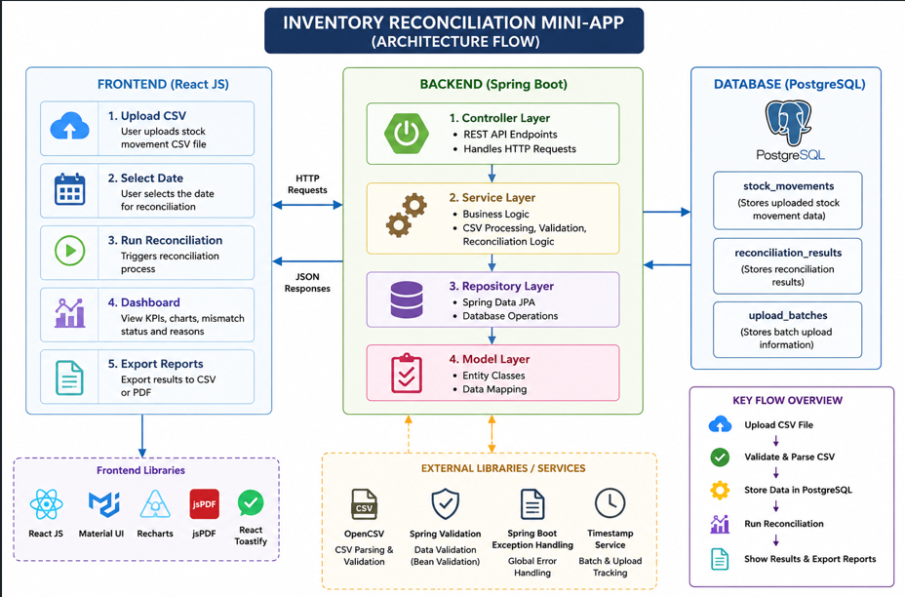
Solution Implementation –High Level Architecture

Slide 6
Solution Implementation
High-level architecture
React UI sends CSV data to Spring Boot APIs ->
Backend processes and reconciles stock –in vs stock –out ->
Result returned to frontend -> displayed through dashboard, tables, and exportable reports.
Major Components / Modules
CSV Upload & Validation
Reconciliation Engine (IN/OUT matching logic)
Insights Dashboard (KPIs, charts, tables)
Export Module (CSV/PDF)
API Layer connecting React and Spring Boot
Technologies or tools used
Frontend : React (UI, Charts, components)
Backend : Java Spring Boot (API, logic , CSV processing)
Data : CSV files
Tools : REST APIs, charting libraries, PDF/CSV export tools

Slide 7
Three Key Features
Questions | Answers
Please elaborate Feature1: | Name: Reconciliation Engine (IN vs OUT Logic) Business description: Compares incoming and outgoing stock for each SKU to find mismatches and calculate correct inventory. Achievements : Enabled real-time mismatch detection, improved accuracy, and reduced manual effort.
Please elaborate Feature2: | Name: Interactive Dashboard & Visualization Business description: Displays reconciliation data using charts (bar, pie) and KPI cards for quick insights. Achievements: Improved data visibility, enabled fast analysis, and provided clear visual representation of mismatches.
Please elaborate Feature3: | Name: CSV Upload & Reporting System Business description: Allows users to upload CSV files and generate reconciliation reports in CSV and PDF formats. Achievements: Automated data processing, avoided duplication with date-based logic, and enabled easy report sharing.

Slide 8
Demo Video With Explanation

Slide 9
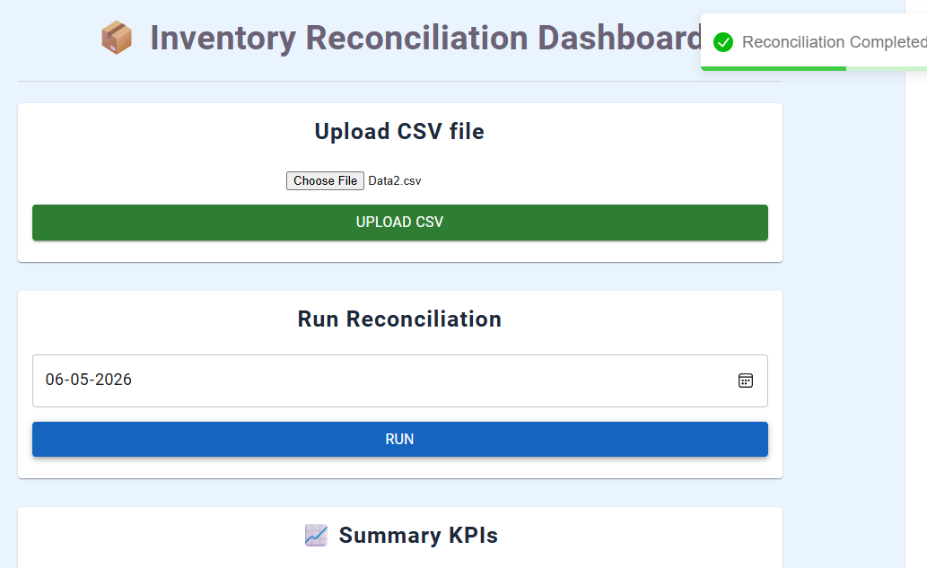
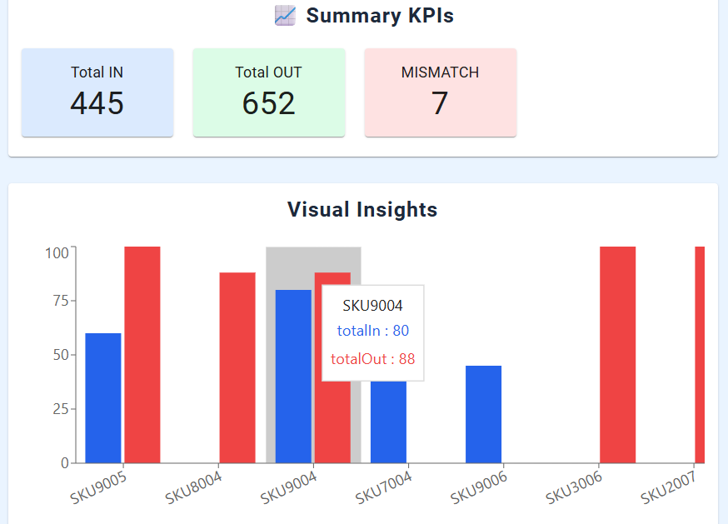
Screenshots
Image 1 – CSV Upload and Reconciliation Execution
This screen allows users to upload the inventory transaction CSV file and select a reconciliation date. After clicking the Run button, the system processes the uploaded data and performs inventory reconciliation.
Image 2 – Summary KPIs and Visual Insights
This dashboard displays key performance indicators such as Total IN, Total OUT, and Mismatch Count. The bar chart provides a visual comparison of stock inflow and outflow for each SKU to find discrepancies quickly.

Slide 10
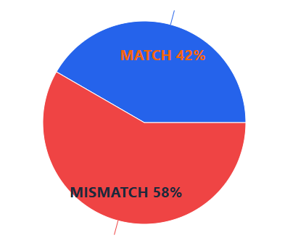
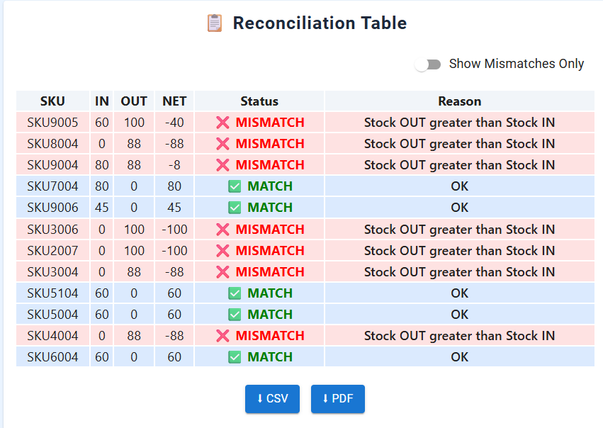
Screenshots
Image 3 – Match vs Mismatch Analysis
The pie chart presents the overall percentage distribution of matched and mismatched inventory records. It helps users understand reconciliation accuracy at a glance.
Image 4 – Complete Reconciliation Report
This table shows detailed reconciliation results for all SKUs, including stock IN, stock OUT, net quantity, status, and mismatch reasons. Users can also export the report in CSV or PDF format.

Slide 11
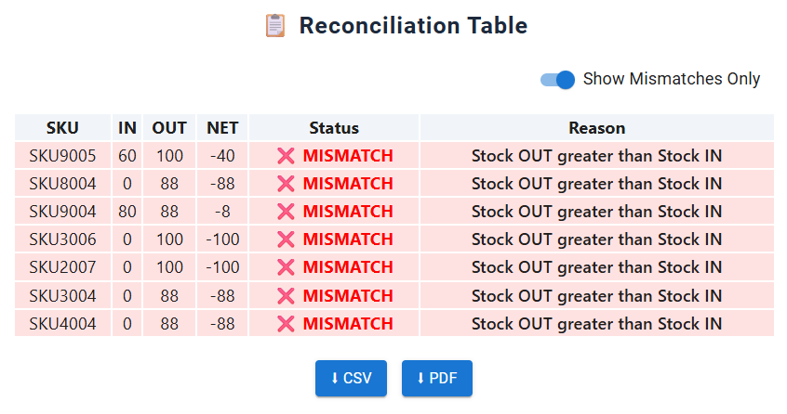
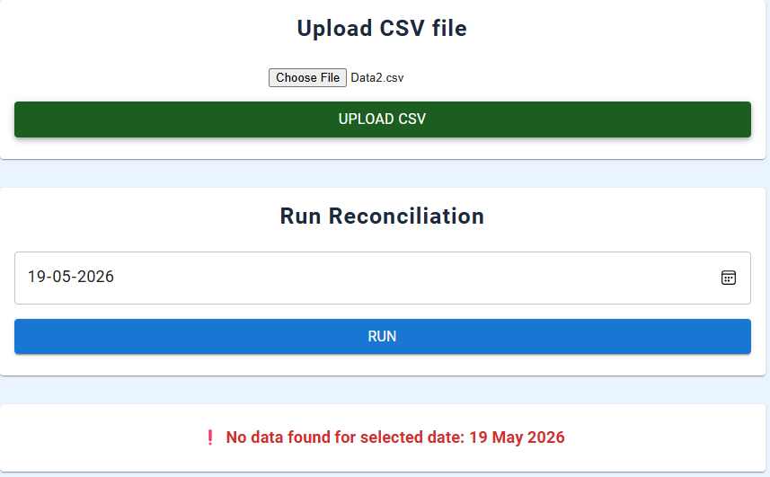
Screenshots
Image 5 – Mismatch-Only View
This filtered report displays only the SKUs with reconciliation issues, making it easier to focus on inventory discrepancies. The mismatch reason column helps identify the cause of each exception.
Image 6 – No Data Available Notification
This screen appears when the selected date has no corresponding inventory records in the uploaded dataset. The system notifies the user and prevents reconciliation for unavailable data.

Slide 12
Outcomes
Questions | Answers
Business impact | Improved inventory accuracy and reduced manual reconciliation Enabled faster detection of stock mismatches Supported better operational decision-making
Achieved Technical benefits | Automated data processing using CSV ingestion Real-time reconciliation using backend logic Interactive dashboard with charts and KPIs
Cost/time/value improvements | Reduced manual effort and time for reconciliation Minimized human errors in stock tracking Increased efficiency in monitoring inventory
Key Metrics | Number of mismatches detected Total IN vs OUT quantities Reconciliation accuracy rate Time saved in report generation

